Slide 1
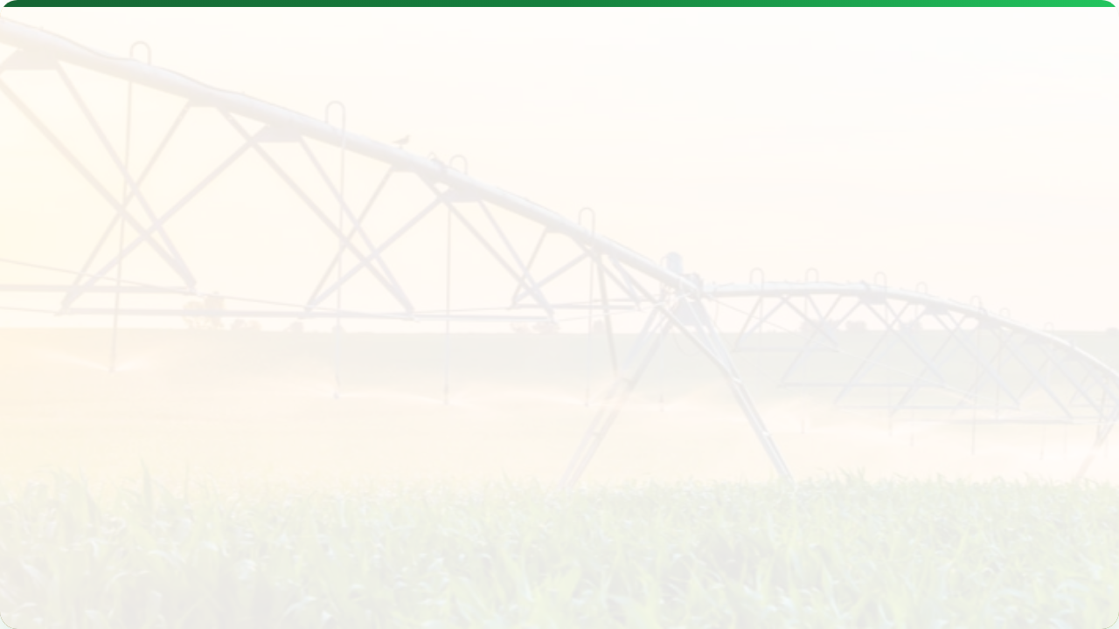



PRECISION IRRIGATION
Lecture 12: Optimizing Water Use
AGE 418
Dr. Kadeghe Fue

Slide 2




Lecture Roadmap
The Why & How
The Brains
Water Scarcity & The "4 R's"
Scheduling: Soil vs. Weather vs. Plant
Methods: Drip vs. VRI Pivot
Automation & IoT
How Variable Rate Irrigation Works
Case Studies & Benefits

Slide 3
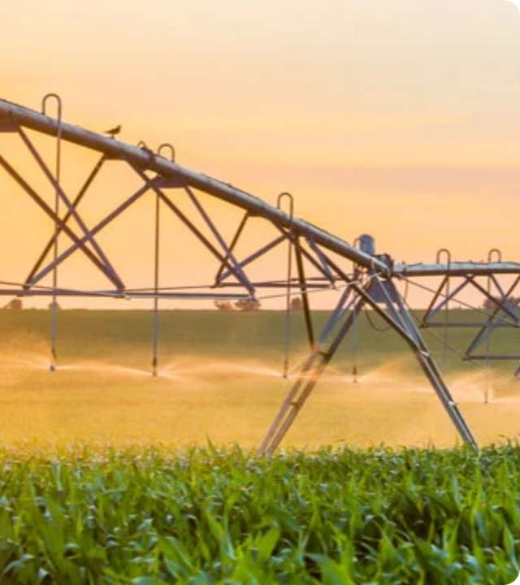

The Challenge
Water Scarcity
Agriculture consumes 70% of global freshwater.
Traditional methods (Flood/Furrow) are only 40-60% efficient.
Precision Irrigation aims for 90-95% efficiency.
"More Crop Per Drop"

Slide 4

What is Precision Irrigation?
Accurately determining and meeting the crop's water needs.
Right Amount
Right Time
Right Place
Not too little (stress), not too much (leaching/waste).
When the plant actually needs it.
Directly to the root zone.

Slide 5


System Components
A closed-loop system.
Sensor: Soil Moisture Probe, Weather Station.
Controller: The computer/timer processing data.
Actuator: Solenoid valves, VRI nozzles, Pumps.

Slide 6
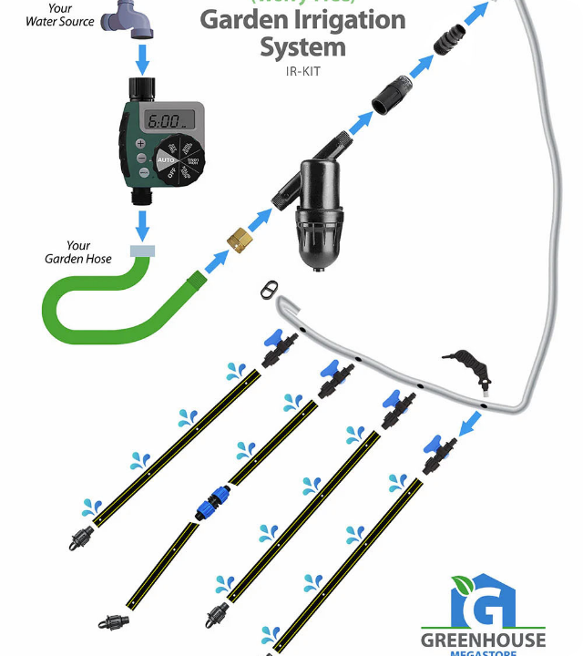
Drip Irrigation
The Gold Standard for Efficiency.
Delivers water directly to the root zone via emitters.
Zero wind drift, zero evaporation.
Precision Aspect: Can be automated based on soil sensors in specific zones.

Slide 7
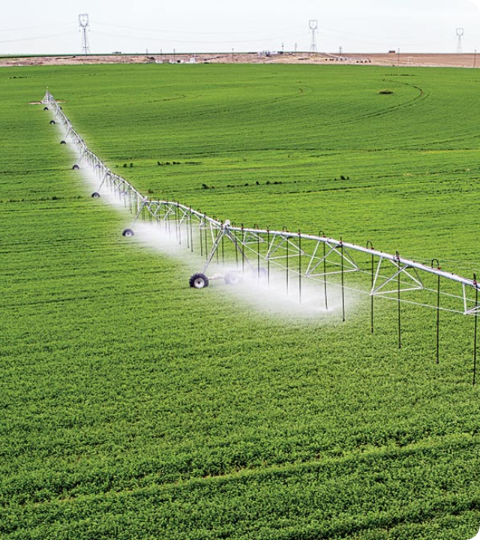
Variable Rate Irrigation (VRI)
For large-scale Center Pivots.
Instead of watering the whole circle uniformly, VRI divides the field into zones (like a pizza).
Zone Control: Speed up/slow down pivot.
Nozzle Control: Individual sprinkler control (Pulse).

Slide 8
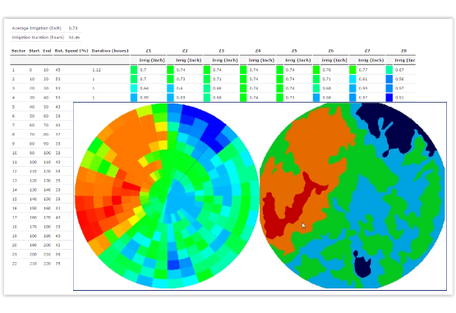
VRI Prescription Map
We map the field based on Soil Texture.
Sandy Zones (Red): Low water holding. Irrigate frequently with small amounts.
Clay Zones (Green): High water holding. Irrigate less frequently.
Wetlands (Blue): Turn nozzles OFF.

Slide 9

Mechanics: Pulse Control
Pulse Width Modulation (PWM) again.
100% Rate
50% Rate
0% Rate
Valve Open constantly.
Valve Open 30s / Closed 30s.
Valve Closed (Crossing a road or creek).
This allows different applications along the same pipe boom.

Slide 10
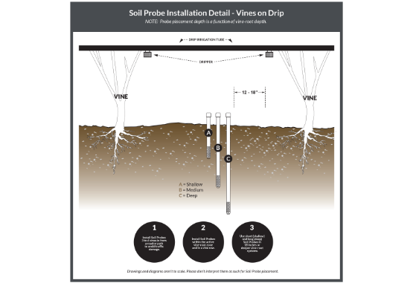
Strategy 1: Soil Moisture
"The Fuel Gauge Approach"
Directly measuring what is in the tank.
Sensors: Capacitance probes at multiple depths (10, 30, 60cm).
Trigger: Irrigate when moisture hits the "Refill Point" (e.g., 50% depletion).

Slide 11
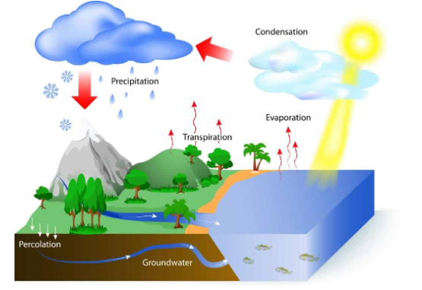
Strategy 2: Weather (ET)
"The Bank Account Approach"
Balancing Inputs (Rain/Irrigation) vs. Outputs (Evapotranspiration).
Formula: $ET_c = ET_o \times K_c$
$ET_o$: Reference ET (Weather Station).
$K_c$: Crop Coefficient (Stage of growth).

Slide 12




Strategy 3: Plant-Based
"Ask the Plant"
A stressed plant closes stomata and heats up.
Thermal Sensors
Dendrometers
Measure canopy temperature (CWSI).
Measure fluctuations in stem diameter (shrinking = stress).

Slide 13
Levels of Automation
Level | Mechanism | Human Role
Manual | Opening valves by hand. | 100% (Decide & Act)
Timer | Clock-based (e.g., "7:00 AM"). | Set schedule (dumb)
Smart | Sensor-based (e.g., "Moisture < 30%"). | Supervise & Monitor

Slide 14
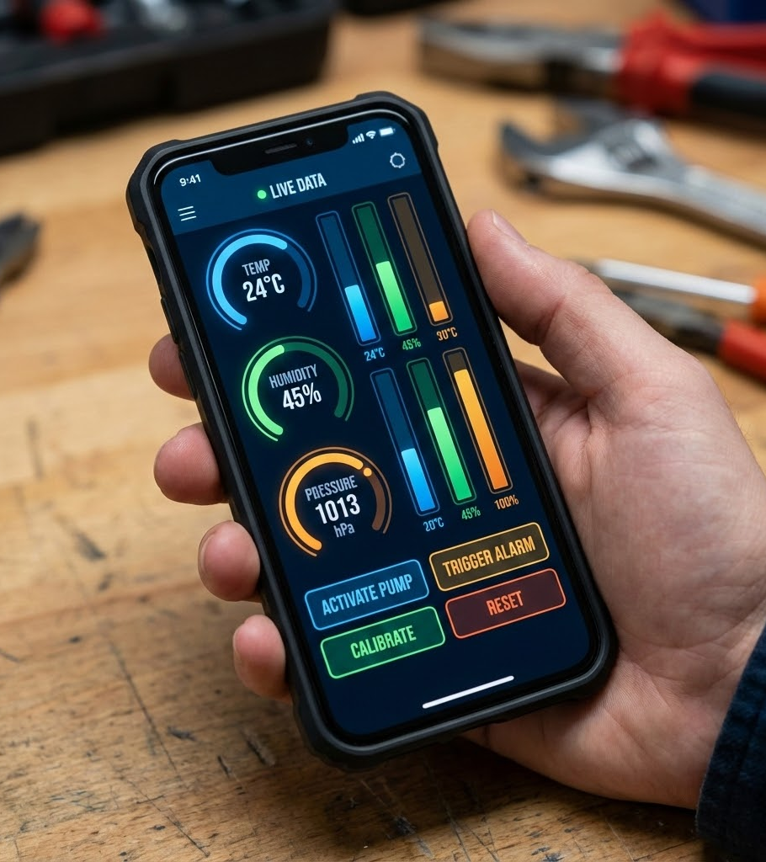
IoT Integration
Control from Anywhere.
Remote Access: Start/Stop pumps from a smartphone.
Alerts: "Leak Detected" or "Pump Failure".
Integration: Weather forecast automatically delays irrigation if rain is coming.

Slide 15

Case Study: Sugar Cane
Scenario
Large estate moving from furrow to Subsurface Drip Irrigation (SDI) with automation.
Results
Water Use: -40% Reduction.
Yield: +25% Increase (Fertigation efficiency).
Labor: Reduced field crew by 60%.

Slide 16





Challenges
Capital Cost
Maintenance
Connectivity
High initial investment for VRI/Drip infrastructure.
Clogging emitters, rodent damage to wires, sensor calibration.
Reliable internet needed for cloud features.

Slide 17
Lecture Summary
Methods
Scheduling
Automation
Drip (Targeted) and VRI Pivots (Zoned) offer the highest efficiency.
Don't guess. Use Soil Moisture sensors or Weather (ET) models.
Smart controllers optimize timing and reduce labor costs.
Next Class: Lecture 13 - Agricultural Robotics

Slide 18

Questions?
Dr. Kadeghe Fue | AGE 418
Sokoine University of Agriculture

